Slide 1
PROSTATE CANCER MANAGEMENT APP
Ericky Dos santos
Damoy Hyman

Slide 2
What is Prostate?
The prostate is a gland in the male reproductive system. It makes most of the semen that carries sperm. The walnut-sized gland is located beneath the bladder and surrounds the upper part of the urethra, the tube that carries urine from the bladder.
Notes:
Explain about prostate.

Slide 3
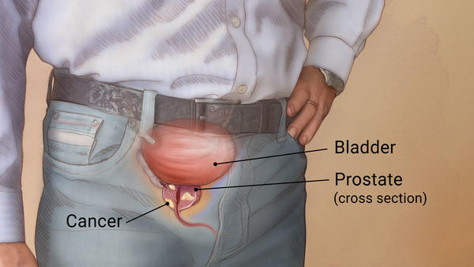
Prostate cancer
Cancer is the growth of abnormal cells.
Cancer cells can invade and damage normal tissue.
Prostate cancer starts in the cells of the prostate.
Some prostate cancers can grow and spread quickly. But most of them grow slowly.

Slide 4
Signs and symptoms of prostate cancer
During the early stages of prostate cancer there are usually no symptoms. Most men at this stage find out they have prostate cancer after a routine check up or blood test. When symptoms do exist, they are usually one or more of the following:
The patient urinates more often
The patient gets up at night more often to urinate
He may find it hard to start urinating
He may find it hard to keep urinating once he has started
There may be blood in the urine
Urination might be painful
Ejaculation may be painful (less common)
Achieving or maintaining an erection may be difficult (less common).

Slide 5
Treatments for prostate cancer
If the cancer is small and contained - localized - it is usually managed by one of the following treatments:
Watchful waiting - not immediate treatment is carried out. PSA blood levels are regularly monitored.
Radical prostatectomy - the prostate is surgically removed.
Brachytherapy - radioactive seeds are implanted into the prostate.
Conformal radiotherapy - the radiation beams are shaped so that the region where they overlap is as close to the same shape as the organ or region that requires treatment, thus minimizing healthy tissue exposure to radiation.

Slide 6
Treatments for prostate cancer Cont.
Intensity modulated radiotherapy - beams with variable intensity are used. An advanced form of conformal radiotherapy usually delivered by a computer-controlled linear accelerator.
Treatment recommendations really depend on individual cases. In general, if there is a good prognosis and the cancer is in its early stages, all options can be considered. However, they all have their advantages and disadvantages. The patient should discuss available options thoroughly with his doctor
Notes:
The patient should discuss available options thoroughly with his doctor
And thus, the creation of the prostate cancer app

Slide 7
The App
The Prostate Cancer Management App is about making it easy for medical patients which are in care for Prostate Cancer to manage their medical data. It is very useful because the patients can, from their smartphones, access the app, upload new data as requested by their doctor, and then view the data they uploaded or view the results which would be automatically generated by parameters created by the doctors.

Slide 8
About the App Cont.
In comparison to the current system where patients have to schedule consults, drive up to their doctor’s office, and let the doctor do the measurements, the patients could do whatever measurements is necessary with the right steps provided and then upload that data to the app. That way, the doctor can look at the specific patient if necessary or simply not do anything and let the automatically generated results take care of the patient.

Slide 9
Illustration of the Prostate Cancer Management App
Notes:
A few screen shots of the Prostate Cancer Management App in action.

Slide 10
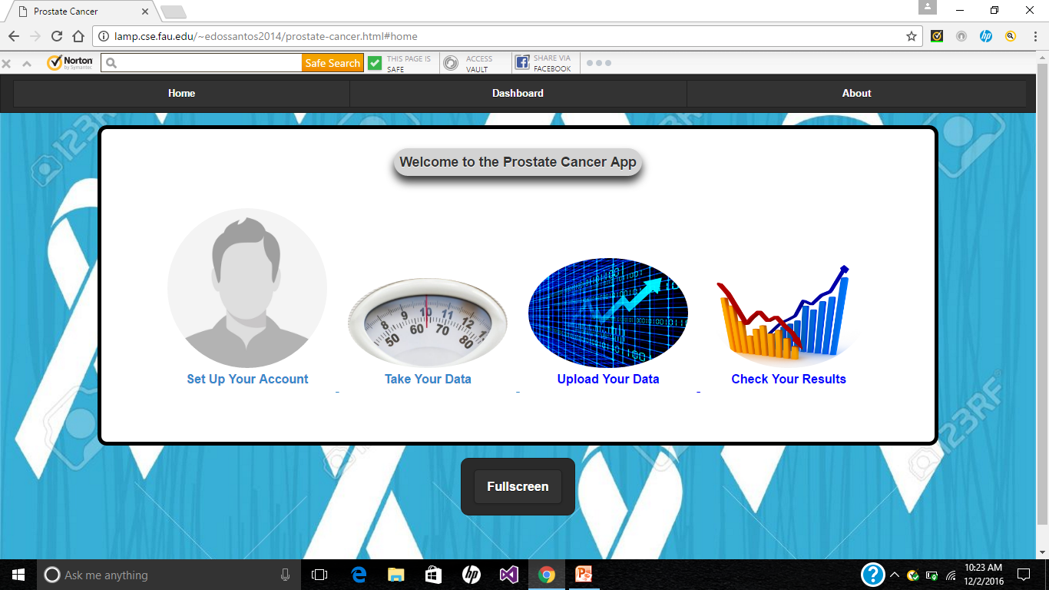
The Home Page
Notes:
This is the home page of the Prostate Cancer Management App, where if they were to click on each individual icons would provide directions
on how to that section to be carried out.
At the top, they would find three navigation bar: Home, Dashboard and About.
The Home navigation would take them back to the home page.
The Dashboard navigation would take them to the page in which they can sign into the app if an account was already created or
signup in order to use the app.
4. The About navigation would give a brief description about the app.

Slide 11
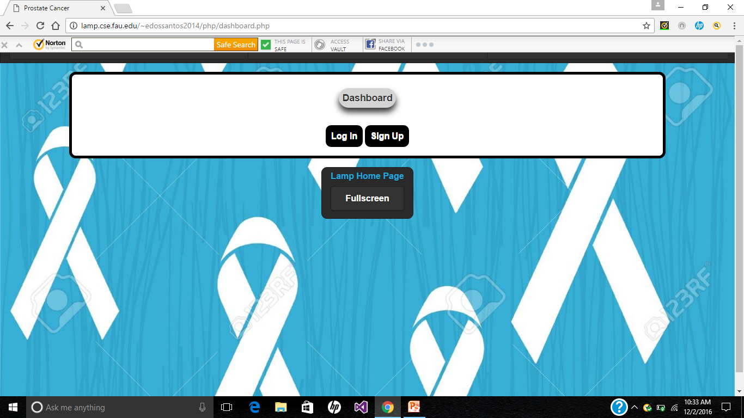
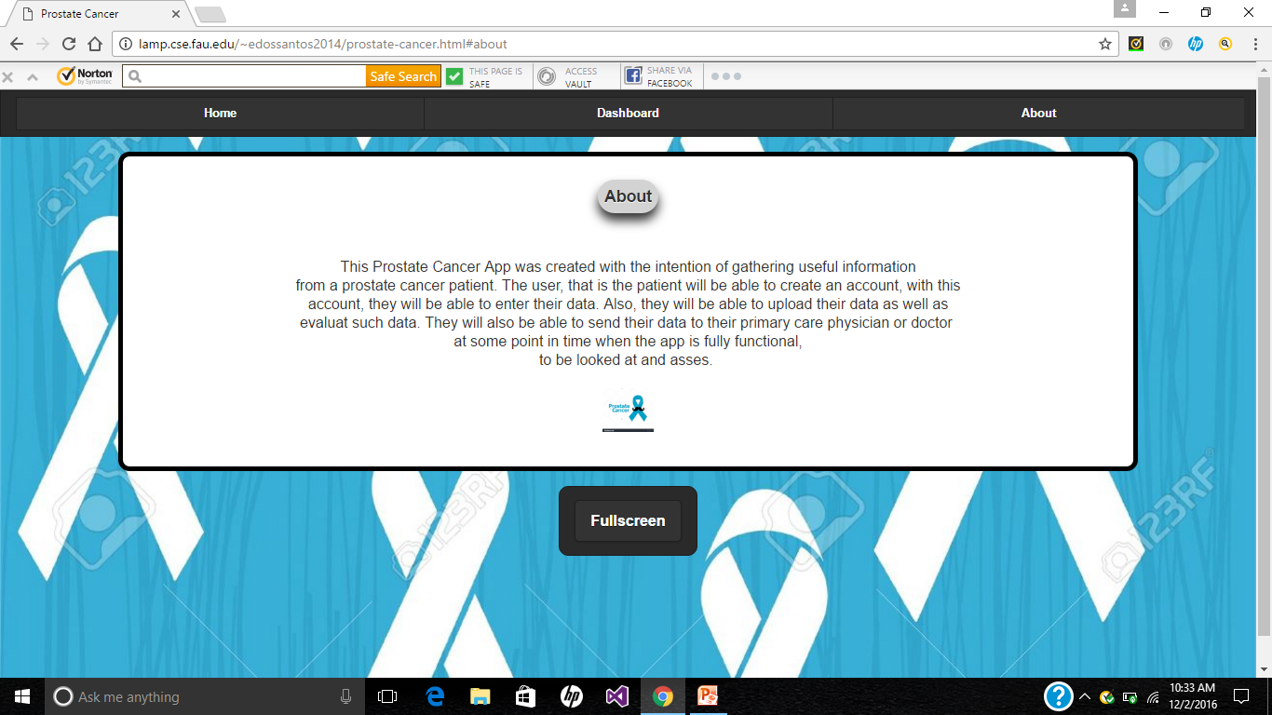
Dashboard Navigation Bar
The About Navigation Bar

Slide 12
Reference
Nordqvist, C. (2016, May 11). Prostate Cancer. Retrieved from Medical News Today.

